Slide 1

DriverPass System Analysis
Nicholas Wood
Notes:
[No speaker notes required for this slide.]

Slide 2

System Requirements
Nonfunctional Requirements
The system should be able to run on a web-based application or a mobile application.
The system should be run off the web preferably over the cloud.
Functional Requirements
The system shall validate user credentials when logging in.
The system shall provide the customer with the ability to modify their profile, including updating name, address, photo, payment options, pickup location, pickup time, and more.
Notes:
Nonfunctional requirements define the systems attributes such as security, performance, scalability, and usability. The speed of the system should be dependent upon the cloud-based server that is chosen. The system should update if there are major changes to the layout or new information is provided. The system should update quickly within real time to account for cancelations and new driving times.
Functional requirements define the functions of the system or its different capabilities. The system shall have the ability for a log in screen and it should be confirmed by the system, they must also have an option to reset the password if needed. The user must be able to change their profile when needed, they may have a different payment option or decide to change their locations.

Slide 3
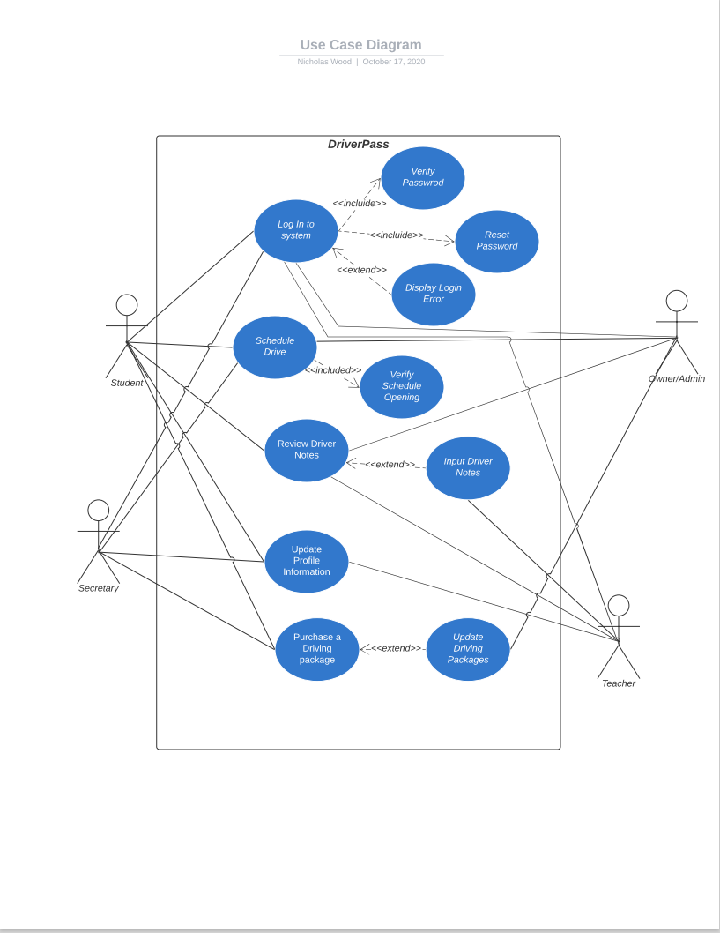
Use Case Diagram
Notes:
This is a use case diagram which explains the different users in a system as well as some of the cases in the system. The actors in the system consist of the student driver, the teacher, the secretary and the owner and admin. Some of the use cases included are the log into system use case, the schedule drive use case, the review driver notes use case, the update profile information use case, and the purchasing driving package use case. Driverpass asked for the students to be able to schedule drives via mobile or web access and we provided that along with the teachers being able to set their availabilities for drives as well. The students also have access to drivers notes that they can review and learn from their past experiences and implement them in their next drives.

Slide 4
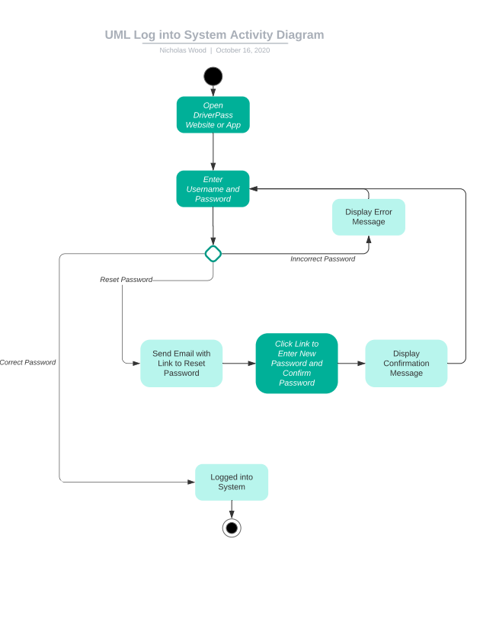
Activity Diagram
Notes:
For this activity diagram I am breaking down the log into system use case. In this activity diagram the user is able to open the DriverPass web page or mobile application and then enter their username and password. DriverPass asked for everyone to have a unique name and have the ability to reset password so we show that if the user wishes they are able to reset their password through an email notification. The email contains a link that allows the user to reset their password. Once it is changed they are brought back to the homepage where they can try and log into the system again. If they are incorrect then an error message is displayed, and they can attempt to log in again.

Slide 5
Security
Each user should have a username unique to each user with the password provided by the user.
The cloud-based provider shall be responsible for the security of the system.
The cloud-based provider should be responsible for the exchange of information within the system.
The cloud should only allow access based on the user role; they are authorized to only access certain information.
Notes:
DriverPass does not want to be responsible for the backup and security of the system, they want to focus on the business aspect of the company. The cloud server should maintain authorization level of each user, we must also consider implementing a limit login attempt before a reset password is sent to the user. Security is very important as we hold the user payment options, having a two-step authorization is also in consideration when logging into the system from an unknown device.

Slide 6
System Limitations
There is currently only 10 cars that are available.
The driving sessions are 2-hour periods.
The teachers do not work 24hrs a day.
Notes:
Some physical limitations are that there are only a total of 10 teachers, this doesn't mean 10 are available all the time, the teachers do not work 24 hours and they may not all be scheduled to work the same day. The driving session are also scheduled for 2-hours, this means they can’t have multiple drives within a couple hours, and they must also be given some extra time because the pickup and drop off location of one student does not match the pickup and drop off location of other students. The budget is also a limitation on the project as it will be based on how the team develops the system and the cost of the cloud-based server must also be taken into consideration.

